Slide 1
SQL
Query Buildings

Slide 2
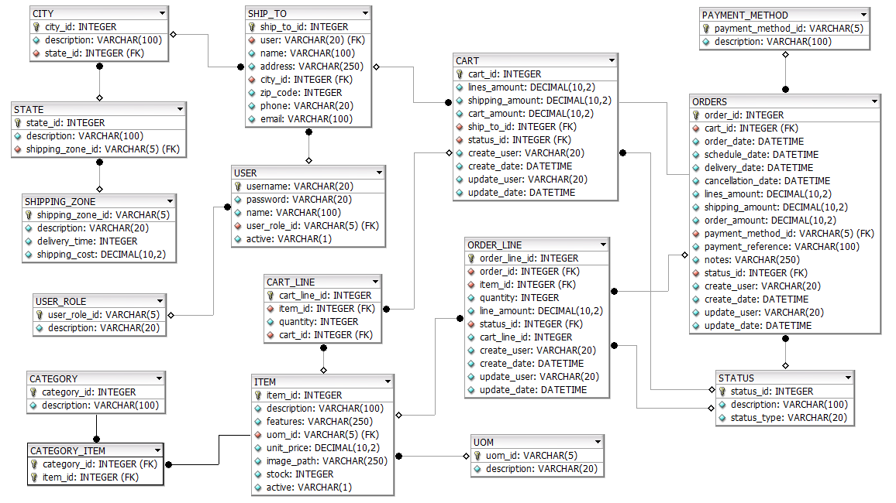
eCommerce DB model

Slide 3

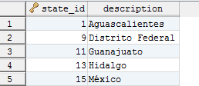
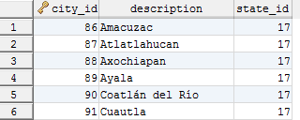
Query Basic Structure
SELECT: Which data do I need?
FROM: Where are data?
WHERE: Which requirements they have to accomplish?
1. Get all Shipping Zones
SELECT * FROM shipping_zone;
2. Get id and description from States of Central Shipping Zone (CT).
SELECT state_id, description
FROM state
WHERE shipping_zone_id = 'CT';
3. Get Cities with id less than 150 and state_id greater than 15.
SELECT *
FROM city
WHERE city_id < 150
AND state_id > 15;
SELECT column_name1, column_name2
, column_nameN
FROM tableName
WHERE column_nameN = valueN;
LOGICAL OPERATORS:
AND, OR, NOT.
NUMERICAL OPERATORS:
=, <, <=, >, >=, !=

Slide 4
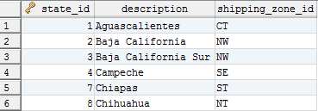
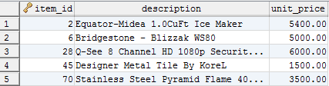
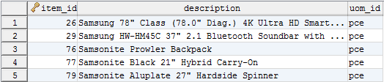
Query Basic Structure
FIELD CONTENT SEARCH:
Like '%' and NULL.
RANGE SEARCH
BETWEEN – AND , IN ( )
4. Get all States containing “ch” as description or state_id between 1 and 10.
SELECT *
FROM state
WHERE description LIKE '%ch%'
OR state_id BETWEEN 1 AND 10;
5. Get id and description from Items starting with “Sams” and measured in “pce” .
SELECT item_id
, description
, uom_id
FROM item
WHERE description LIKE 'Sams%'
AND uom_id = 'pce';
6. Get id and description from Items with price in a range ($ 1,500 - $ 7,500) and id among 2,6,20,28,40,45,60 and 70.
SELECT item_id
, description
, unit_price
FROM item
WHERE unit_price BETWEEN 1500 AND 7500
AND item_id IN (2,6,20,28,40,45,60,70);

Slide 5
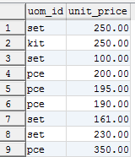
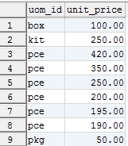
Query Basic Structure
DISTINCT: Avoids duplicate results
GRUP BY: To group duplicate results in a single result
ORDER BY: To sort the the result
7. Get all distinct uom_id, price from Items where price are less than 500.
SELECT DISTINCT uom_id, unit_price
FROM item
WHERE unit_price < 500;
8. Get grouping values to uom_id, price from Items where price are less than 500, ordered first by uom_id, and then by price.
SELECT uom_id, unit_price
FROM item
WHERE unit_price < 500
GROUP BY uom_id, unit_price DESC;

Slide 6
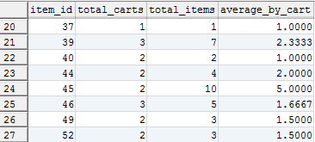
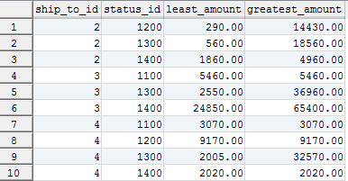
Agregate Functions and Aliases
Only "Group By" columns and Summarized expressions(COUNT, SUM, AVG, MAX, MIN) should belong to SELECT clause
9. Get total_carts containing an item, total_ítems and average of ítem by carts; all from each ítem in CartILine. Sort the result by ittem_id.
SELECT item_id
, COUNT(cart_id) AS total_carts
, SUM(quantity) AS total_items
, AVG(quantity) AS items_by_cart
FROM cart_line
GROUP BY item_id
ORDER BY item_id;
10. Get the least and the greatest amounts from each ship_to_id and status_id from Carts and sort the result by ship_to_id and status_id.
SELECT ship_to_id
, status_id
, MIN(cart_amount) AS least_amount
, MAX(cart_amount) AS greatest_amount
FROM cart
GROUP BY ship_to_id
, status_id
ORDER BY ship_to_id;

Slide 7
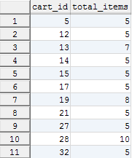
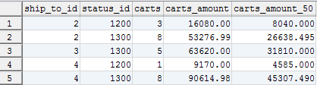
Having
Lets us to set filters on results of Aggregate functions in a Query. Only "Summary Columns" can belong Having clause
11. Get cart_id and total_ítems for each Cart in CartILine where total_ítems is greater than 4.
SELECT cart_id
, SUM(quantity) AS total_items
FROM cart_line
GROUP BY cart_id
HAVING SUM(quantity) > 4
ORDER BY cart_id;
12. Get the number of carts by ShipTo and Status from Carts “NOT-CANCELED” and the 50% of sum of cart_amount on each group is greater than $ 4,000.
SELECT ship_to_id
, status_id
, COUNT(cart_id) AS carts
, SUM(cart_amount) AS carts_amount
, SUM(cart_amount * 0.5) AS carts_amount_50
FROM cart
WHERE status_id != 1400 --1400: Canceled
GROUP BY ship_to_id
, status_id
HAVING carts_amount_50 > 4000
ORDER BY ship_to_id;

Slide 8

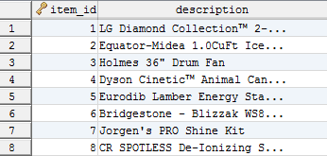
MySQL Functions
STRING FUNCTIONS:
CONCAT(string1, string2, stringN, …)
LENGTH(string)
SUBSTR(string, index_init, nun_characters)
REPLACE(string, to_replace, replacement)
IF (contidion, vaule_true, vaue_false)
14. Get item_id and uom_id concatenated to description from Items where length of description is less than 25 characters.
SELECT item_id
, CONCAT(uom_id, ' - ', description) AS descr
FROM item
WHERE LENGTH(description) < 25;
15. Get the first 25 characters of description Items. If the legth of description is greater htan 25 it has to be truncated to 25 and concatenated to “…”.
SELECT item_id
, IF (LENGTH(description) > 25
, CONCAT(SUBSTR(description,1,25), '...')
, description) AS description
FROM item;

Slide 9
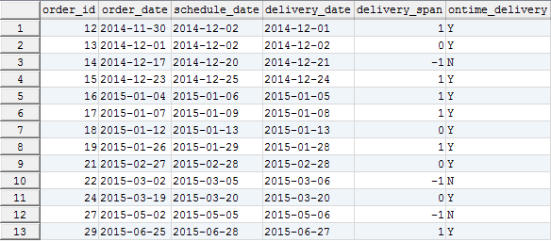
MySQL Functions
DATE / TIME FUNCTIONS:
CURRENT_DATE(), LOCALTIME()
DATE_FORMAT(date, format)
DATE_ADD(date, INTERVAL n (DAY|MONTH|YEAR))
DATEDIFF(date1, date2)
16. Create a report with the relevant dates with format “YYYY-MM-DD” from Orders “Delivered” and “Partially Delivered”, created last 2 year. Include the Delivery Span (in days) between scheduled_date and delivery_date, and a ontime_delivery_flag showing if Orders were delivered_ontime (Y) or not (N).
SELECT order_id
, DATE_FORMAT(order_date,'%Y-%m-%d') AS order_date
, DATE_FORMAT(schedule_date,'%Y-%m-%d') AS schedule_date
, DATE_FORMAT(delivery_date,'%Y-%m-%d') AS delivery_date
, DATEDIFF(schedule_date, delivery_date) delivery_span
, IF (DATEDIFF(schedule_date, delivery_date) >= 0, 'Y', 'N') AS ontime_delivery
FROM orders
WHERE status_id IN (2300,2350)
AND order_date > DATE_ADD(CURRENT_DATE, INTERVAL -2 YEAR);

Slide 11

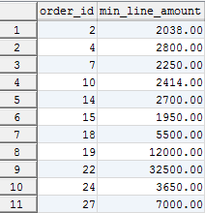
Query Buildings - Exercises
1. Get all Items containint ‘set’ as description and unit_price between 500 and 23000.
2. Get amount of carts per ShipTo from Cart with Status other than Created.
3. Get the mínimum_line_amount per Order from OrderLines where status_id are among (3100, 3300) and the minumum_line_amount is greater than 1,500.

Slide 12

Query Buildings - Exercises
4. Create a report from Orders that includes per payment_method_id the total of orders in each Status. The report has to cosider only Order with dada of 2015.

Slide 13
Jorge Luis Gonzalez
jorge.gonzalezm@softtek.com
Instructor

